Slide 1
Introduction to AI Technologies
1st
Mar 3, 2023
Graduate School of Urban Innovation
Doctoral course for working adults (1st grade)
Tomoichi Ebata

Slide 2
1. Self-introduction

Slide 3
1-1. Introduction to my two personality
As a senior researcher for work days
A researcher has worked for a company that contributes to society with "technology" as my company motto
→ not "love", "money", "sincerity", or "kindness"
A engineer has worked for many targets
→ from rail, power, transportation, GPS, networks, engines, microwave ovens, to data analysis
A Sucker for first things
→ I've dabbled in most of the AI technology.
As a weekend writer and researcher
Contributed technical columns from April 2012-
(Approximately 150 columns)

Slide 4
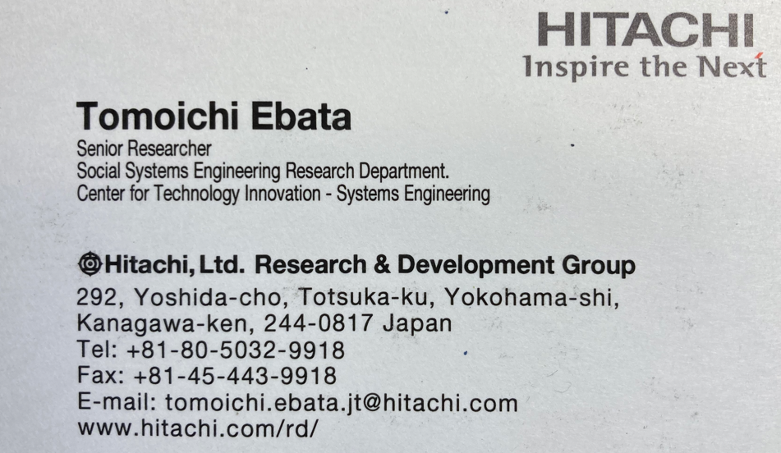
1-2. Introduction for my work days
My Business Card

Slide 5
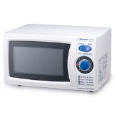

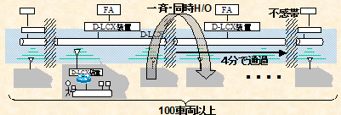
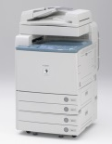
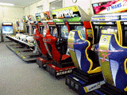
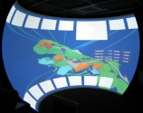

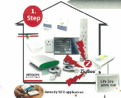
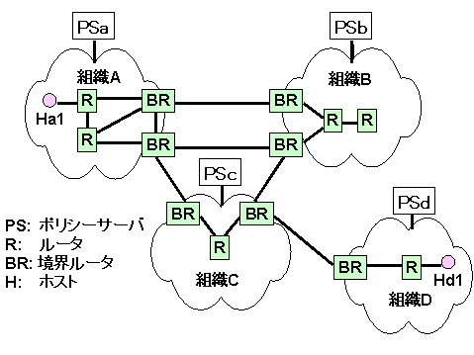

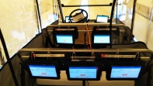
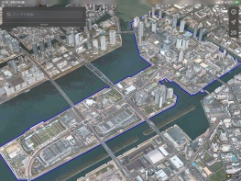
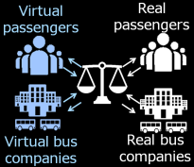
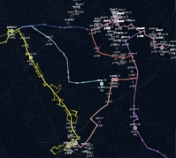
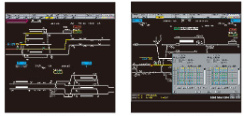
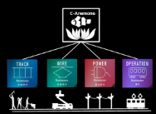
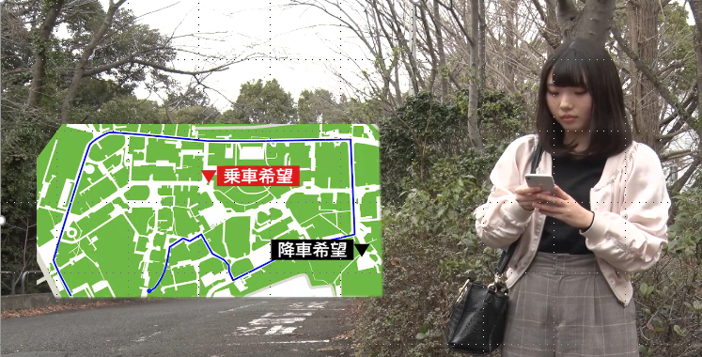
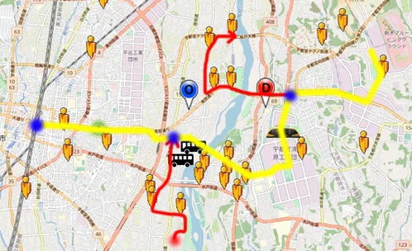
1-3. My work history
Fuzzy Neuro Appliances
Location-based app
Shinkansen Internet
in U.S.
Wide-area autonomous distributed communication middleware
Wide-area facility and equipment monitoring
Traffic measurement
Policy Network
IP-OSS
Video surveillance
ad hoc network
Home M2M
FOKUS Kyoken (Germany)
France Telecom(France)
HP (U.S.)
UCI(U.S.)
1991
95
98
2002
06
09
Indoor GPS
60,000 Person Railway Simulation
One Million Passengers Simulation under train accident
120,000 on-demand simulation
Tomioka Demonstration
Toyosu Simulation
Utsunomiya
Simulation
Traffic Management System(China)
U-Blox (Swiss)
Train Online Maintenance
ATOS Replacement
Information Control PF
Symbiotic self-regulatory decentralization
YNU Demonstration
13
16
18
19
2020
21
22
Busy days at various works

Slide 6


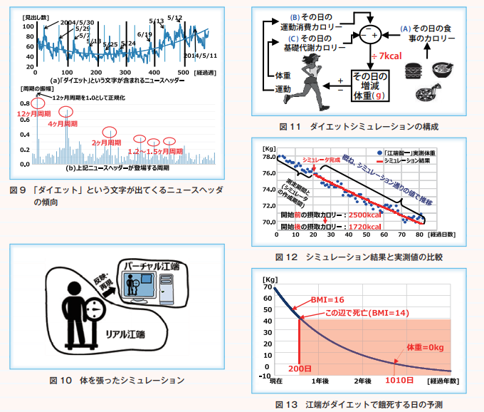
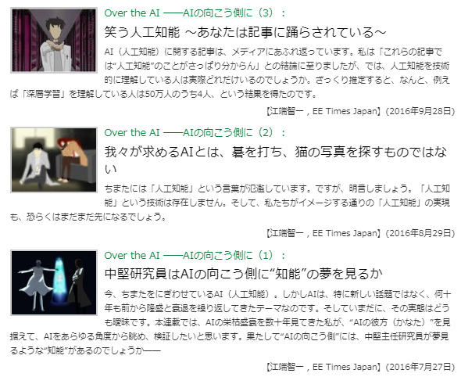
1-4. My weekend contents
Please read the following columns for reference (Sorry, just in Japanese version)
https://www.jstage.jst.go.jp/article/bplus/12/4/12_271/_pdf
https://eetimes.itmedia.co.jp/ee/series/3761/
Lectures using the above content

Slide 7
2. What’s AI ?

Slide 8
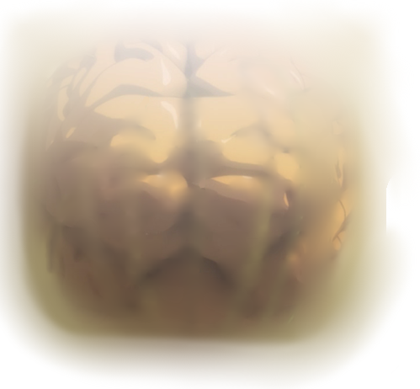
2. AI is not technology
AI is just a “concept”
■Probability theory
■Optimization Algorithm
■Statistics
■Image recognition
■Voice recognition
■Constraint theory
■Natural language processing
■Search
AI
(Artificial Intelligent)
■Game theory
■ OR
■Neural Networks
■Machine learning
■Automatic Translation
■Human interface
■Case-based reasoning
■Multi-agent simulation
■Expert
■Bayesian network
■Data mining
■Genetic Algorithm (GA)
■Fuzzy reasoning
consisting of many software tech.

Slide 9
3. Schedule

Slide 10
3. Today’s Topics
Fuzzy and Bayesian
■Probability theory
■Optimization Algorithm
■Statistics
■Image recognition
■Constraint theory
■Voice recognition
■Search
■Natural language processing
AI
(Artificial Intelligent)
■ OR
■Game theory
■Machine learning
(Mar 17th)
■Neural Networks
(Mar 10th)
■Human interface
■Automatic Translation
■Multi-agent simulation
■Case-based reasoning
■Bayesian network
(Mar 3rd) Today
■Expert
■Data mining
■Genetic Algorithm (GA)
(Mar 17th)
■Fuzzy reasoning
(Mar 3rd) Today

Slide 11
4. Fuzzy Reasoning

Slide 12
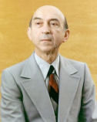
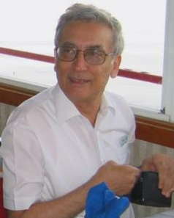
4.1 What’s “Fuzzy reasoning”
Methods to enable computation with "language”
■To handle “ambiguity” of language Mathematically
  Utilize knowledge expressed in language
  → (e.g.) "Report written in Japanese" is used as it is.
  Rigid mathematical objectivity is not always necessary
  → In fact, the real world operates on "language"
■Advocator: Prof. Zadeh
■Systematization: Prof. Mamdani
■Commercialization: Japanese
manufacturers companies
e.g. Hitachi, Matsushita Co. , etc.

Slide 13
4.2 Fuzzy Logic
Real numbers (fuzzy numbers) not limited to 0/1, can be used in computers
■Two-valued logic
P | Q | P ∩ Q | P ∪ Q | ￢P
Input
0 | 0 | 0 | 0 | 1
0 | 1 | 0 | 1 | 1
1 | 0 | 0 | 1 | 0
1 | 1 | 1 | 1 | 0
P
Q
P
Q
P
■Fuzzy logic
P | Q | P ∩ Q | P ∪ Q | ￢P
Input |  | Min(P,Q) | Max(P,Q) | 1-P
0.85 | 0.17 | 0.17 | 0.85 | 0.15
0.01 | 0.88 | 0.01 | 0.88 | 0.99

Slide 14
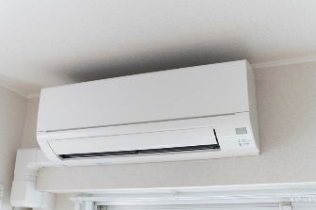
4.3 Fuzzy Reasoning(Calculation)
Introducing the Mamdani (min-max) method using a cooler control program as an example
■Fuzzy Rules
■Fuzzy Membership function
(Rule 1) "If the temperature is high and the humidity is high, turn “cool(-1)”.
(Rule 2) "If the temperature is normal and the humidity is high, turn “stop(0)”.
(Rule 3) "If the temperature is high and the humidity is normal, turn “cool(-1)”.
(Rule 4) "If the temperature is low and the humidity is low, turn “heating (+1)”.
Low
Middle
High
10 20 30 deg.
(a) Temperature
Low
Middle
High
■Fuzzy Table
30 50 70 ％
No need to fill all cells.
(b) humidity
Temp. Humi. | Low | Middle | High
Low | Heat(+1)
Middle |  |  | Cool(-1)
High |  | Stop(0) | Cool(-1)
COOL
ZERO
HEAT
-1 0 +1
(c) Switch

Slide 15
(Rule 1) "If the temperature is high and the humidity is high, turn “cool(-1)”.
[Step 1] Fuzzy computation by Rule 1
(a) Temperature
(b) humidity
(c) Switch
10 20 30 deg.
30 50 70 ％
-1 0 +1
If X and Y then Z
27.0 deg.
57%
Min(X_{i},Y_{i})
Max
(Min(X_{i},Y_{i}))

Slide 16
4.4 How to calculate the reasoning result?(1)
How to switch on the air conditioner, when temp. is 27.0 deg. and humidity = 57% ?
[Step 1] Fuzzy computation by Rule 1
(a) Temperature
(b) humidity
(c) Switch
10 20 30 deg.
30 50 70 ％
-1 0 +1
27.0 deg.
57%
+
[Step 2] Fuzzy computation by Rule 2
(a) Temperature
(b) humidity
(c) Switch
10 20 30 deg.
30 50 70 ％
-1 0 + 1
27.0 deg.
57%

Slide 17
4.5 How to calculate the reasoning result?(2)
[Step 3] Fuzzy computation by Rule 3
(a) Temperature
(b) humidity
(c) Switch
10 20 30 deg.
30 50 70 ％
-1 0 +1
27.0 deg.
57%
+
[Step 4] Fuzzy computation by Rule 4
(a) Temperature
(b) humidity
(c) Switch
10 20 30 deg.
30 50 70 ％
-1 0 + 1
27.0 deg.
57%
-0.684(Reasoning Result)
Switch might be “-1(Cool)“

Slide 18
[Step 1] Fuzzy computation by Rule 1
(a) Temperature
(b) humidity
(c) Switch
0.7
Min(0.7,0.35)
0.35
10 20 30 deg.
30 50 70 ％
-1 0 +1
27.0 deg.
57%
+
[Step 3] Fuzzy computation by Rule 3
(a) Temperature
(b) humidity
(c) Switch
0.7
Min(0.7,0.65)
0.65
10 20 30 deg.
30 50 70 ％
-1 0 +1
27.0 deg.
57%
Max(Min(0.7,0.35), Min(0.7,0.36)) = 0.65

Slide 19
(c) Switch
0.65
0.30
0.00
-1 0 +1
-0.684(Reasoning Result)
= (-1 x 0.65 + 0 x 0.30 + 1 x 0.00)/
( 0.65 + 0.30 + 0.00)

Slide 20

Exercise
How to switch on the air conditioner, when temp. is 27.0 deg. and humidity = 67% ?
You use the same fuzzy rules, fuzzy membership functions and the same way of the above 4.2～4.4
The correct answer is -0.70 , so please write down the calculation process.
You could refer the programming code →

Slide 21
4.6 Application “Emotional Modeling”(1)
Negative impact of Boss's return time
Hypothesis: If boss goes home early,
everyone goes home early.
 | Hypothesis | Simulation Policy
#1 | I don't leave until my work is done. | I am not influenced by others about my work.
#2 | When my boss is working overtime, "it's hard to go home." | (A) Section chiefs care about department heads and newcomers cares about department heads, but the reverse is not true.
 |  | (B) Newcomers don't care about the senior managers (not the instructor).
#3 | Boss's seat nearby is "hard to go home to." | Everyone is affected by distance from their boss.
#4 | However, there are limits. | No extra-long overtime(2 hours)

Slide 22
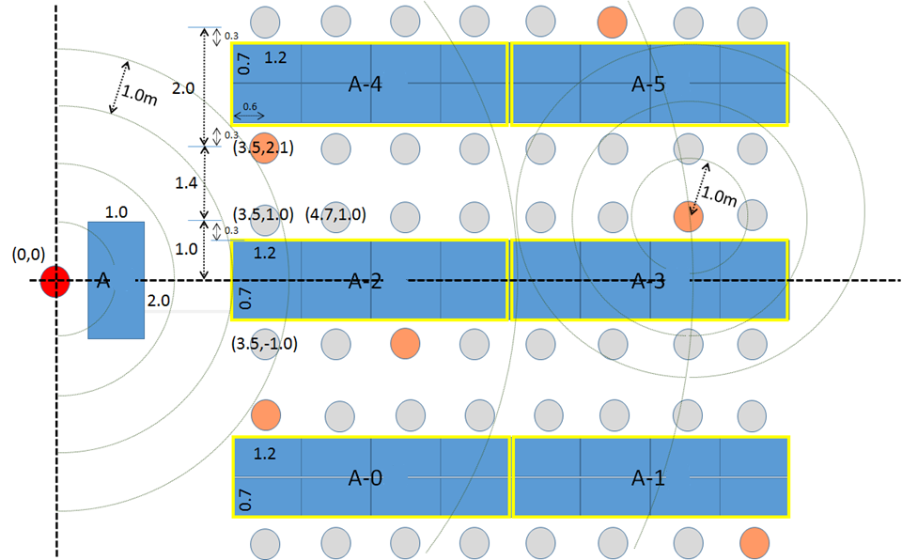
4.7 Application “Emotional modeling”(2)
Office Environment:
49 persons, consisting of 6 divisions.
Head of department
Employment
Division manager

Slide 23
4.8 Application “Emotional modeling”(3)
Fuzzy Rule table using language
 |  | Distance between your boss seat and your seat
 |  | Very short | Short | So-so | Long | Very long
Time after my work | Soon | Can’t go home | Can’t go home | Can’t go home | (No Rule) | Can go Home
 | About 1 hour | Can’t go home | Can’t go home | (No Rule) | Can go Home | Can go Home
 | About 2 hour | Can’t go home | (No Rule) | Can go Home | Can go Home | Can go Home

Slide 24
4.9 Application “Emotional modeling”(4)
Change time to go home for the head manager
[Number]
20:00
21:00
22:00
50
40
30
20
10
0
17:30
18:30
19:30
20:30
21:30
22:30

Slide 25
4.10 Application “Emotional modeling”(5)
If the head manager is absent
[Number]
20:00
21:00
22:00
50
49 persons
40
30
Everyone returns home at "21:00"
20
10
0
17:30
18:30
19:30
20:30
21:30
22:30

Slide 26
5. Bayesian Reasoning

Slide 27
5.1 What’s “Bayesian Reasoning”
■When the cause and effect are known, the reasoning can be traced back
from the result to the cause.
Using the data "If you join a marriage party, you
can get married," we want to know,
"What is the probability that a married person
had a marriage party at least once a month?”
It turns into “Monetary Value“.

Slide 28
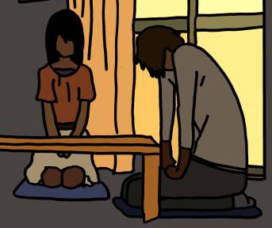
5.2 Reversal of Causes and Effects
Example 1: "When your partner cheat, you can find someone's underwear."
Affair
Underwear
To Reverse Cause and Effect
"What is the probability that your partner cheats, when you find the underwear?"
Affair
Underwear

Slide 29
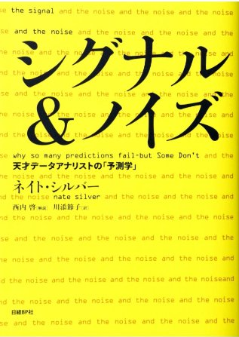
5.3 How to understand with "underwear"
■Exhibit: "Signal & Noise" by Nate Silver
■Questions
  You (woman) return home from
  a business trip and find unknown
  underwear in your wardrobe
This is the "condition"
What is the probability that your partner (man) is cheating on you when you find the underwear?
This is "conditional probability"
It's not just “probability"

Slide 30
5.4 Required Information in advance
Probability of cheating according to general statistics → 4%.
(2) Estimate of “cheating” when
underwear is found → 50%.
(3) Estimate of “not cheating” when
underwear is found → 5%.
It could be a gift for me. (I don’t to want to think it), however, it could be my partner's property (hobby).
In this case, (2) and (3) are "subjective" values

Slide 31
5.5 Realizing by the Numbers(1)
10000 people
Cheaters
400 people
(4%)
10000人 x P(Cheaters)
= 10000人 x 4%
= 400 people

Slide 32
5.6 Realizing by the Numbers(2)
10000 people
When the underwear is discovered, the person who is cheating
200
people
10000 x P(cheaters) x P(underwear|cheaters)
= 10000 x 4% x 50%
= 200 people

Slide 33
5.7 Realizing by the Numbers(3)
10000 people
When the underwear is discovered, the person who is NOT cheating
480人
10000 x P(cheaters) x P(underwear|NO cheaters)
= 10000 x 96% x 5%
= 480 people

Slide 34
5.8 Realizing by the Numbers(4)
10000 people
Partners found in underwear
680人
200 + 480
= 680

Slide 35
5.9 Realizing by the Numbers(5)
10000 people
What is the percentage of people who are found underwear and are cheating?
200 /680
= 29.4%
When underwear is found, what is the partner (male) probability that he is cheating on you? = 29.4 %
(Up from the original probability of 4 %)

Slide 36
5.10 Prior probability & posterior probability
Prior probability
Posterior probability
10000
400
200
680
400人÷10000
=0.04
200人÷680
=0.29
The object of calculation changes.

Slide 37
5.11 Bayes' theorem
P(cheat|underwear) =
P(cheat)4% x P(underware|cheat) 50%
10000 x
P(Cheat) x P(underwear|cheat) + P(No cheat)xP(underwear|no cheat)
x
x
10000 x
4%
50%
10000 x
96%
5%
=
P( A | X )
P( A ) P( X | A )
200
P( A ) P( X | A ) + P( A ) P( X | A )
200
480
P( A ) P( X | A )
P( A | X )
=
P( X )
Even if you forget "Theorem“, remember "Underwear"

Slide 38
5.11-2 Bayes' theorem
A→X
Affair
Underwear
A → X
P( A ) P( X | A )
P( A | X )
=
P( X )
A’←X’
Affair
Underwear
A’ ← X’

Slide 39
Exercise
See 5.4 and calculate a new “Posterior probability” using the following numbers.
Probability of cheating according to general statistics → 4% 10%
(2) Estimate of “cheating” when
underwear is found → 50% 60%
(3) Estimate of “not cheating” when
underwear is found → 5% 10%
Please write down the calculation process and the answer.

Slide 40
5.12 Application(1)
Ebata's private questionnaire on Artificial Birth Technology
http://biz-journal.jp/2014/01/post_3940_5.html
Question | Contents
Question 1: | Should "frozen eggs" and "frozen sperm" be utilized?
Question 2: | Should we develop an "artificial uterus device"?
Question 3: | Are children born with an "artificial uterine device" different?
Question 4: | Can you love a child born with an "artificial uterus device"?
Question 5: | Should "technology" be used to reduce fertility?
Number of respondents 16

Slide 41
5.13 Application(2)
List of Questionnaire Results
ID | Attribute |  |  | Q.1 | Q.2 | Q.3 | Q.4 | Q.5
A | Woman | 15year |  | Pro | Con | Yes | No | No need
B | Woman | 20year |  | Con | Con | Yes | Unknown | No need
C | Woman | 20year |  | Unknown | Con | Yes | No | Unknown
D | Woman | 20year |  | Pro | Unknown | Unknown | Yes | Unknown
E | Woman | 25year |  | Unknown | Unknown | No | Yes | No need
F | Woman | 35year | Married | Pro | Pro | Yes | Yes | Need
G | Woman | 35year | Married | Pro | Pro | No | Yes | No need
H | Woman | 35year |  | Pro | Unknown | Unknown | Unknown | Need
I | Man | 35year | Married | Pro | Con | Yes | No | Need
J | Man | 35year | Married | Pro | Pro | No | Unknown | Need
K | Man | 35year | Married | Con | Pro | No | Yes | Unknown
L | Man | 40year |  | Pro | Con | Yes | Yes | No need
M | Man | 45year | Married | Con | Con | Yes | Yes | Need
N | Man | 45year | Married | Pro | Con | Yes | Unknown | Need
O | Woman | 50year | Married | Con | Con | Yes | Unknown | Unknown
P | Woman | 55year | Married | Pro | Con | Unknown | Yes | Need
What do you read from this list?

Slide 42
5.13 Application(3)
IDPro | Attribute |  |  | Q.1 | Q.2 | Q.3 | Q.4 | Q.5
A | Woman | 15year |  | Pro | Con | Yes | No | No need
B | Woman | 20year |  | Con | Con | Yes | Unknown | No need
C | Woman | 20year |  | Unknown | Con | Yes | No | Unknown
D | Woman | 20year |  | Pro | Unknown | Unknown | Yes | Unknown
E | Woman | 25year |  | Unknown | Unknown | No | Yes | No need
F | Woman | 35year | Married | Pro | Pro | Yes | Yes | Need
G | Woman | 35year | Married | Pro | Pro | No | Yes | No need
H | Woman | 35year |  | Pro | Unknown | Unknown | Unknown | Need
I | Man | 35year | Married | Pro | Con | Yes | No | Need
J | Man | 35year | Married | Pro | Pro | No | Unknown | Need
K | Man | 35year | Married | Con | Pro | No | Yes | Unknown
L | Man | 40year |  | Pro | Con | Yes | Yes | No need
M | Man | 45year | Married | Con | Con | Yes | Yes | Need
N | Man | 45year | Married | Pro | Con | Yes | Unknown | Need
O | Woman | 50year | Married | Con | Con | Yes | Unknown | Unknown
P | Woman | 55year | Married | Pro | Con | Unknown | Yes | Need
 |  |  |  | Pro | Pro | Yes | Yes | Need
A→X
?
A’ ← X’

Slide 43
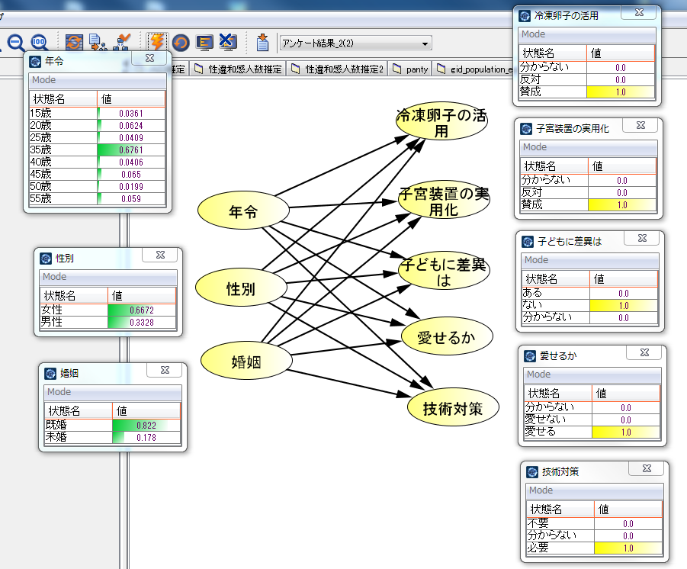
5.14 Application(3)
Who's Pro for "artificial birth technology?"
35 year
“Pro” for all items
Woman
Married
Change the results,
change the conditions.

