Slide 1
Introduction to AI Technologies
2nd
Mar 10, 2023
Graduate School of Urban Innovation
Doctoral course for working adults (1st grade)
Tomoichi Ebata

Slide 2
2. Today’s Topic

Slide 3
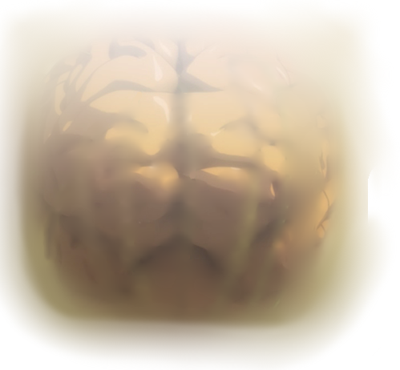
2. Today’s Topics
Neural Network
■Probability theory
■Optimization Algorithm
■Statistics
■Image recognition
■Constraint theory
■Voice recognition
■Search
■Natural language processing
AI
(Artificial Intelligent)
■ OR
■Game theory
■Machine learning
(Mar 17th)
■Neural Networks
(Mar 10th) Today
■Human interface
■Automatic Translation
■Multi-agent simulation
■Bayesian network
(Mar 3rd)
■Case-based reasoning
■Expert
■Data mining
■Genetic Algorithm (GA)
(Mar 17th)
■Fuzzy reasoning
(Mar 3rd)

Slide 4
3. Neural Network

Slide 5
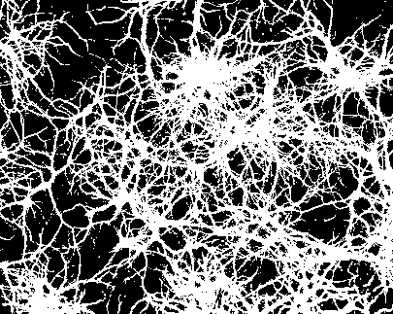
3.0 Neural Network
Each of the 100 billion neurons in the cerebrum has 1500 synaptic connections
struct synapse{
NERUO departure_nero;
NEURO arrival_neuro;
double weight;
} SYNAPSE;
struct neuro {
SYNAPSE synapse[1500];
double sumption;
double weight;
double threshold;
double sigmoid(double x);
} NEURO;
The coding is just image of real Neural Network Ebata made

Slide 6



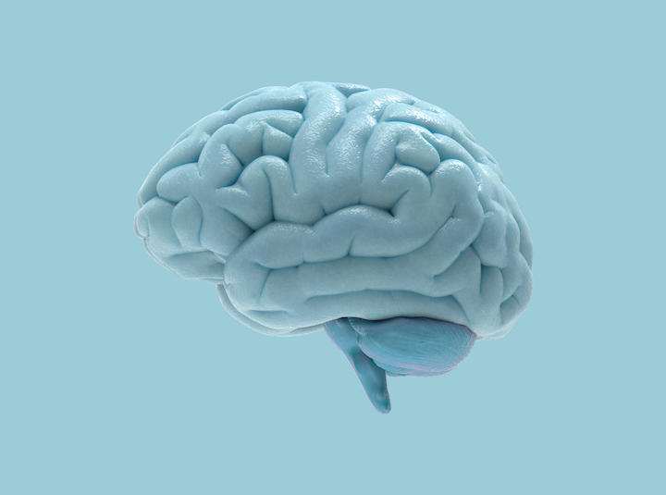
Incredible massively parallel processing
Assuming that each neuron has 3,000 double types (16-bit), and given that there are 100 billion neurons, a rough calculation shows that 37.5 terabytes (TB) of storage space is all that is required to achieve this.
4TB HDD x 10
16GB memoryCard x 2400
If we limit ourselves to the "capacity" of the brain, current computer hardware is now can be achieved!
But… the calculation times are
More than 100 days
Within 2 seconds

Slide 7
3.1 What’s “Neural Network(NN)”
(1)Useful completion functions, and or
(2) Ultra-high recognition method
■ Most importantly, NN makes problems easier for us.
No logic, No algorithm and No mechanism is required, however
powerful computer resources are require absolutely.
■Success of NN learning depend on your "luck" or
"intuition".
In fact, there is a disgustingly large number of examples of
"learning failures“
Today, I would like to talk to you the real NN’s stories

Slide 8
3.2 What’s “Neural Network(NN)”
A model of human brain cells (neurons) that can learn input-output relationships by force.
Middle layer
Input layer
Output layer
Input pattern
Output pattern
Neuron
Synapse
Why the NN works well?
No one can explain it.
“Work well” is just “work well”

Slide 9
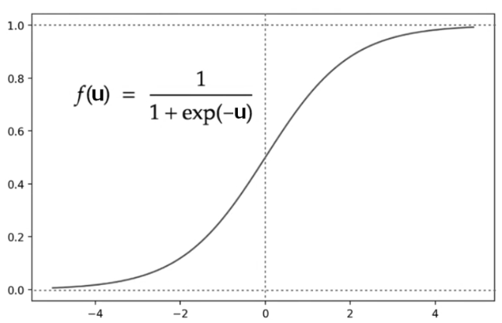


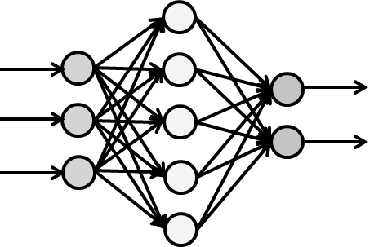
3.3 What’s “Neural Network(NN)”
The mechanism is very simple
X₁
u = W₁ X₁ +W₂ X₂ +W₃ X₃ + b
W₁
X₂
+b
f(u)
f(u)
W₂
1
=
X₃
W₃
1 + exp(-u)
■f(u) has just two states:
0(no ignition) and 1(ignition)
■NN is the chain of ignition
“NN learning" means keeping “W” and “b” changing.

Slide 10
3.4 How to learn NN
The learning is complex
■ How many W and b are needed in the following NN?
W: 3 + 3 x 5 + 5 x 2 = 28
(Numbers of Link(Arrow))
b: 3 + 5 + 2 = 10
(Numbers of Node)
■ How to find W and b that satisfy all "Input/Output
patterns"?
How do we find all these annoying, troublesome, enormous variables?

Slide 11
3.5 Purpose of NN
Making a “magic box” to get an answer
without logic and algorithm
[output:Y0].
Commitment to Accuracy
[Input: X0] Understanding of my emotion
[output:Y1].
Commitment to Honesty
[Input: X1]
Understanding of your partner’s emotion
Married Life Diagnosis NN
[output:Y2].
Commitment to Rudeness
[output: Y3].
Commitment to Idiot
[Input: X2].
Controlling both partner’s and my emotions
[output: Y4].
Commitment to Big-mouth

Slide 12






3.6 Preparing the learning data
First, collect several learning data
X0=
0.5
Y0=1
X0=
0.1
Y0=0
X0=
0.4
Y0=0
Y1=0
Y1=1
Y1=0
X1=
0.3
X1=
0.6
X1=
0.2
Y2=0
Y2=0
Y2=0
Y3=0
X2=
0.3
Y3=0
X2=
0.6
Y3=0
X2=
0.8
Y4=0
Y4=0
Y4=1
X0=
0.8
Y0=0
X0=
0.2
Y0=0
X0=
0.4
Y0=0
Y1=0
Y1=0
Y1=1
X1=
0.3
X1=
1.0
X1=
0.2
Y2=0
Y2=1
Y2=1
Y3=1
X2=
0.8
Y3=0
X2=
0.6
Y3=0
X2=
0.1
Y4=0
Y4=0
Y4=1
More data is better,
but also more difficult to learn.

Slide 13
3.7 How to learn the data
Back-propagation to find proper “W” and “b”
Keep changing the values of W and b until the output is the same as the learning data
Input data
Actual output
Output
data
Wij
Y0=0.3
Wij
＋0.7
Y0=1
X0=0.5
Y1=0.7
-0.7
Y1=0
Y2=0.2
X1=0.3
-0.2
Y2=0
Y3=0.4
-0.4
Y3=0
X2=0.8
Y4=0.0
0.0
Y4=0
Input data → data output → back-propagation
recently until values converge

Slide 14
Y₀,…,Y₅ = f(X₀, X₁, X₂)

Slide 15
Y₀,…,Y₅ = f(X₀, X₁, X₂)

Slide 16
Y₀,…,Y₅ = f(X₀, X₁, X₂)

Slide 17
It's like creating a completion function.
Y₀,…,Y₅ = f(X₀, X₁, X₂)

Slide 18

3.8 How to use the NN
Learned NN analyzes Ebata's Married life
Subject: Tomoichi Ebata
Y0=0.92
X0=0.5
Y1=0.72
X1=0.7
Y2=0.68
Y3=0.53
X2=0.8
Y4=0.52
The report (example)
Summary:
Overall, the subjects' marriages contain risks, especially in the areas of "Accuracy" and "Honesty”….
...and, well, this is how it will be used.

Slide 19
Putting values into the completion function
Y₀,…,Y₅ = f(X₀, X₁, X₂)
×

Slide 20
3.9 XOR problem using NN(1)
An example of an approach to understanding the greatness of NN
Problem: Separate blue ● and red ● into groups.
Y
Y
1
1
Cannot be separated by linear
Failure Patterns
0
X
0
X
0
1
0
1
Y
Y
1
1
Can be separated by non-linear
Success Patterns
0
0
0
1
X
0
1
X
XOR separation problem is quite difficult

Slide 21
3.10 XOR problem using NN(2)
Success or failure of learning is left to chance
The initial values (random numbers) of “W” and “b” make such a difference.
[sum of differences]
1.2
1
0.8
[Learning Failure]
0.6
0.4
0.2
[Learning Success]
0
0
100
200
300
400
500
600
700
800
900
1000
[number of times]

Slide 22
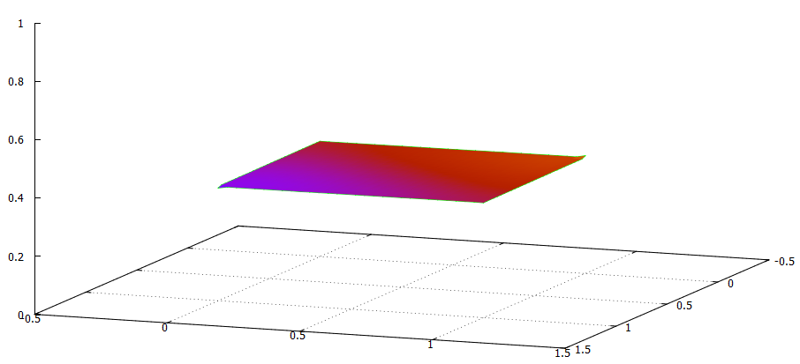
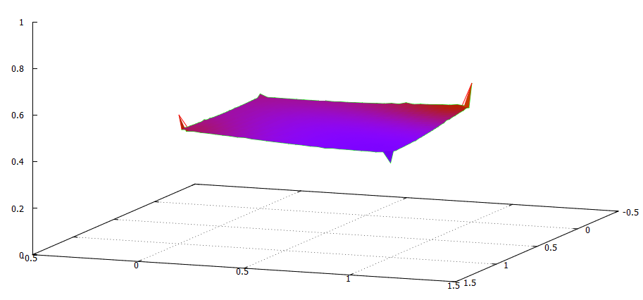
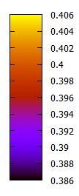

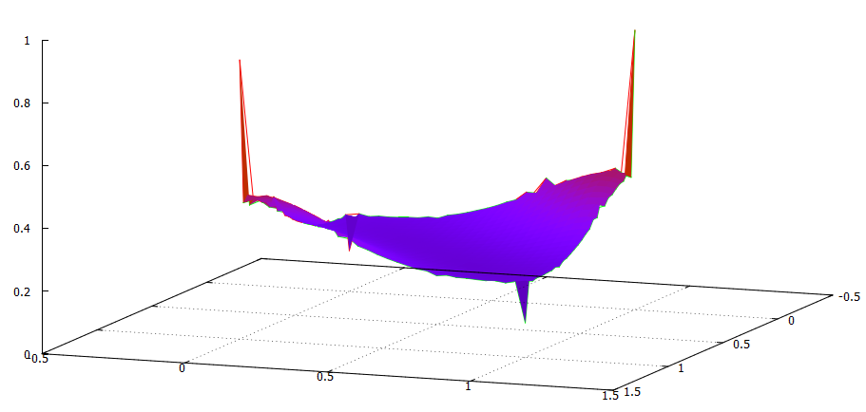
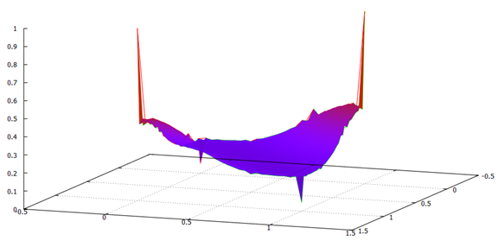
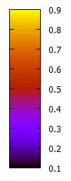

3.11 XOR problem using NN(3)
Over-learning
Tends to overlearn only where there is training data.
(0,0)
(1,0)
(0,0)
(1,0)
(0,1)
(1,1)
(0,1)
(1,1)
1 time
300 times
(0,0)
(0,0)
(1,0)
(0,1)
(1,0)
(0,1)
(1,1)
(1,1)
500 times
1000 times

Slide 23
(0,0)
(1,0)
(0,1)
(1,1)
1000 times

Slide 24
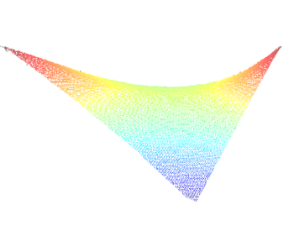
Using Fuzzy XOR
(0,0)
(1,0)
(0,1)
(1,1)
1000 times

Slide 25
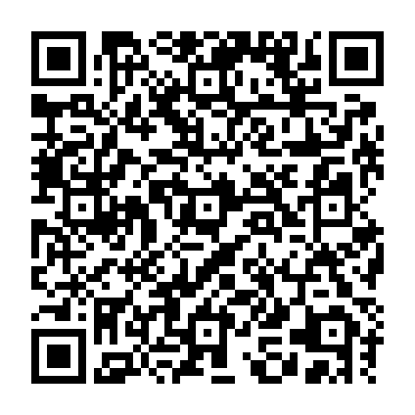
Exercise
Using the neural network to realize “XOR”,
Calculate the following pattern
Ebata made the following “NN” using the program →
W[0][A]
W[0][B]
W[A][Z]
w[0][A]:2.590875
w[1][A]:2.589988
w[2][A]:3.983865
w[0][B]:4.212212
w[1][B]:4.209405
w[2][B]:1.481688
w[A][Z]:-15.881664
w[B][Z]:14.684265
w[C][Z]:6.487656
X
0
A
Y
1
B
Z
Z
f(u)
1
-1.0
W[B][Z]
=
2
-1.0
C
1 + exp(-u)
W[C][Z]
Question 1. Calculate Z when X=0.0, Y=0.0
Question 2. Calculate Z when X=1.0, Y=0.0
(Question 3. Calculate Z when X=0.7, Y=0.1, if you have time)
Please write down the calculation process “Simply”.
You can use “calculator”, and any device

Slide 26
Intermission 1

Slide 27
What AI technologies drove each AI boom?
There have been three AI booms
1960
1970
1980
1990
2000
2010
2020
First Boom
Ice
age
Second Boom
Ice
age
Third boom
(a) Hack “human brain”
Neuro
(Multilayer net)
Neuro
(deep learning)
Neuro
(Perceptron)
(b) Hack
“Human Behavior”
Expert Systems
Fuzzy
Genetic Algorithm
Machine (Reinforcement) Learning
(c) Be Nerd

Slide 28
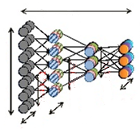
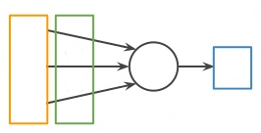
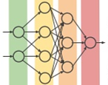
A Terrible History of Neural Networks(1)
The "flip-flop" was repeated twice.
1960
1970
1980
1990
2000
2010
2020
First Boom
Ice
age
Second Boom
Ice
age
Third boom
Multilayer net
deep learning
Perceptron
Linear data can always be separated (awesome!)
Non-linear data can also be separated (awesome!)
Super multi-layer and big data learning! (Amazing!)
Respect

Slide 29
A Terrible History of Neural Networks(2)
AI researchers can "disparage" a technology today they "respected" until yesterday
Linear data can always be separated (awesome!)
Non-linear data can also be separated (awesome!)
Super multi-layer and big data learning! (Amazing!)
Respect
No help for data that cannot be separated (No,No)
？
What Will Happen
Low learning success rate (No,No)
Disrespect

Slide 30
I'm tired of hearing "AI will replace humans"
Doctors and professors readily make unsubstantiated predictions
■Predictions of the first boom
→ Herbert Simon: "Within 20 years, anything a man can do will be done by a machine" (1965)
→ Marvin Minsky: "Within a generation [most of] the problems that will give rise to artificial intelligence will be solved" (1967).
■Predictions of the second boom
→Raj Reddy, Director of the Robotics Institute at Carnegie Mellon University:
"There are 25 million people working in manufacturing in the U.S. today. By 2010, this number will be reduced to 3 million.
■Third boom (current) statement
→ Many people continue to make the same statements as above.

Slide 31
4. DNN：Deep Neural Network

Slide 32
4.1 Two types of DNN
Just remember that there are two types: "supervised" and "unsupervised."
Type | Name | Meaning | Expected output
Supervised | Full linkage | A large amount of data with paired inputs and outputs. | When new data is input, proper data is output
 | CNN
 | RNN
Unsupervised | Boltzmann | A large amount of input data | Output 1/0 answer
 | AE
“Unsupervised" does not mean "no learning data"

Slide 33
4.2 CNN and AE
These two differences are enough, so you can “forget" others
Abbr. | Name | Contents
CNN | Convolutional Neural Network | Learning efficiency (speed and scale) is amazing.
AE | Auto Encoder | Discrimination capability is amazing(e.g Cats and Dog)
Both are great technologies, but difficult to find “how to use them”

Slide 34




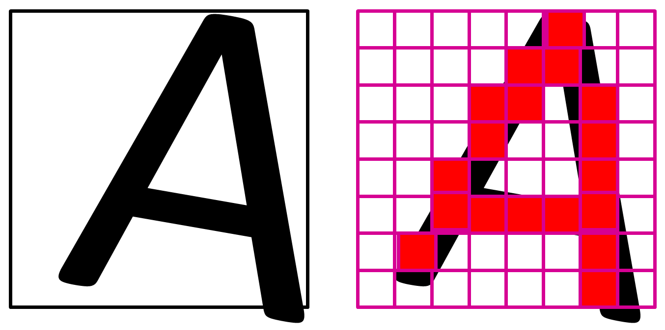



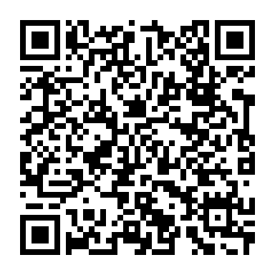
4.3 How to understand CNN
I wrote the program and handcrafted the learning data
Data of “A” | Data of “B” | Data of “C” | Data of “D”
Source codes are here →
If simple back-propagation,
it almost always fails to learn.

Slide 35
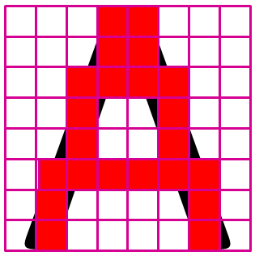
4.4 CNN Process(1)
This part is not learning, just pre-processing.
filtering
convolutional processing
Pooling processing

Slide 36
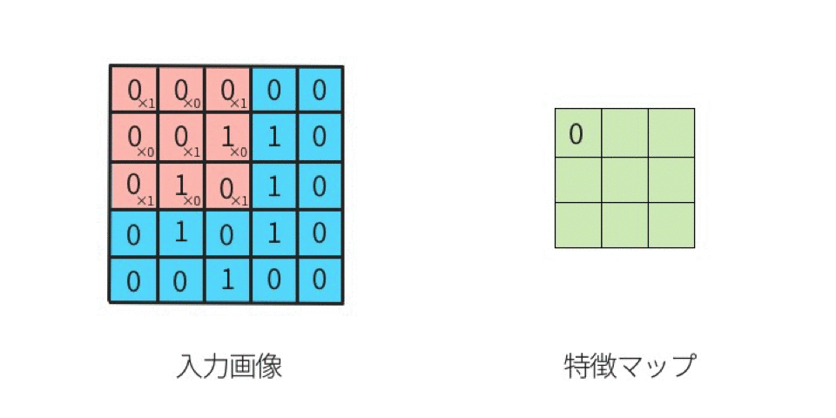
1 0 1
0 1 0
1 0 1
Filter
Image
Processing

Slide 37
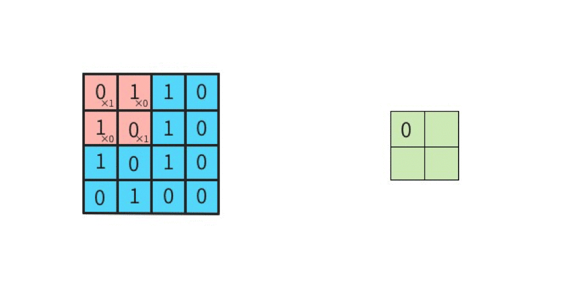
1 0
0 1
Filter
Image
Processing

Slide 38
4.5 CNN Process(2)
Pre-processing has been completed to make the data easy to learn and converge.
For 8 pieces of learning data
For the first 9 filters
For the 2nd 9 filters
A
B
C
D
Range of back propagation learning

Slide 39

4.6 CNN Process(3)
Dare to filter "complete information"
The effect is to strengthen the "characteristics" of the learning data

Slide 40

4.7 CNN Process(4)
A large number of back-propagation
C:convolutional layer
R: Activation layer
P: Pooling layer
A: Affine conversion layer
S: Softmax layer
C
R
P
C
R
P
A
R
A
S
White dog
F
F
F:Filter
(A) Forward propagation
correction
C
R
P
C
R
P
A
R
A
S
Black
Cat
F
F
(B) Back propagation

Slide 41
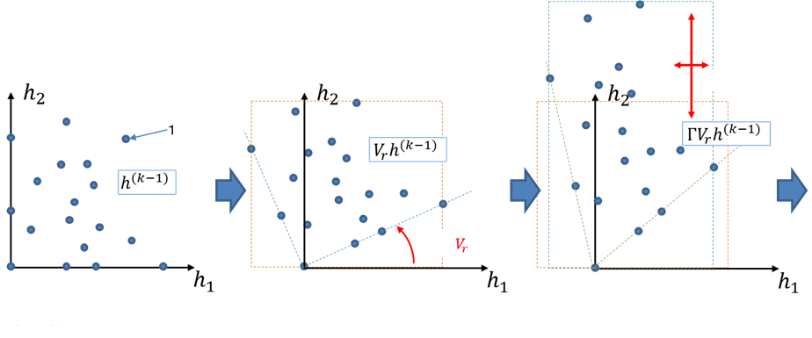
Affine conversion
Sample
Affine conversion
(Rotation)
Affine conversion
(scaling)

Slide 42
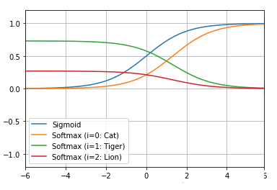
SoftMax Funcion

Slide 43




4.8 CNN Process(5)
Implementation of discrete backpropagation with segmented neural networks
C
R
P
W
C:convolutional layer
R: Activation layer
P: Pooling layer
W:Filter

Slide 44


4.9 AE Process(1)
AE is learning yourself in the mirror
The Middle layers are needed
Range of "working hard" in back propagation learning

Slide 45
4.10 AE Process(2)
Learning by using learned "layers"
Decreasing the size of the "layers" one after another
Next step
Forget this layer
Next step
Forget this layer

Slide 46
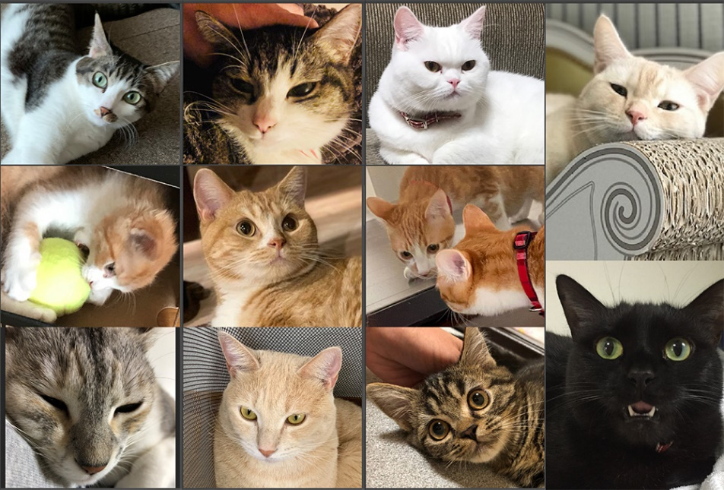
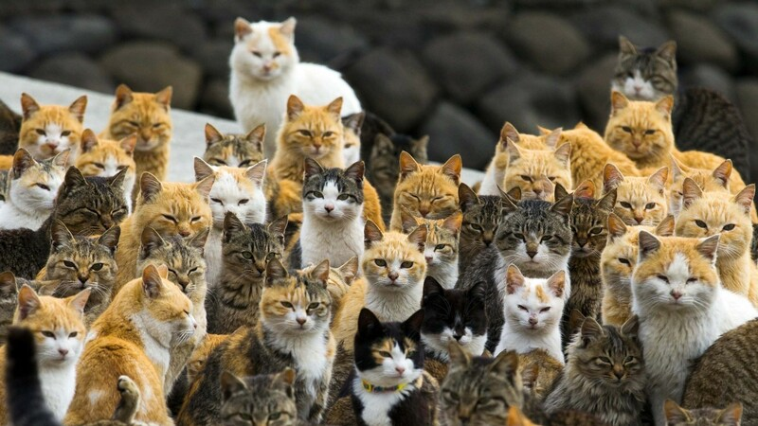
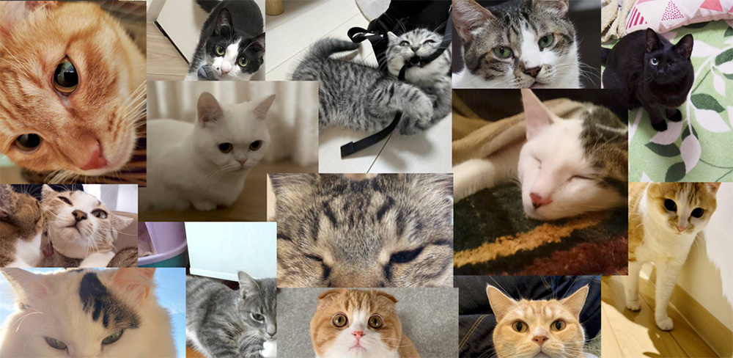
Cat, Cat, Cat, Cat, Cat, Cat, Cat, Cat…

Slide 47


4.11 AE Process(3)
Completion of a device that reacts to specific "objects”
・・・
Get excited when I see "cats"
Not get excited when I see “dogs”

Slide 48
Intermission 2

Slide 49
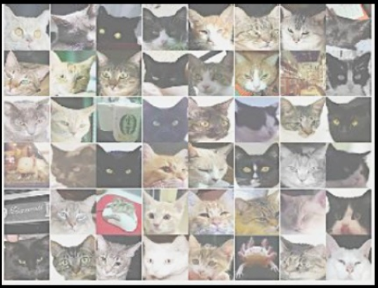
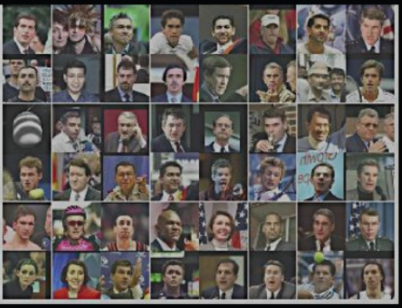
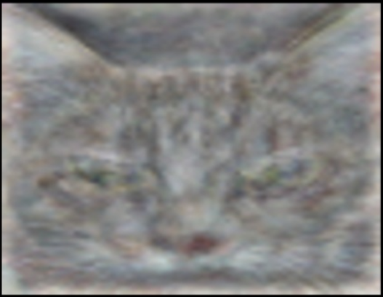
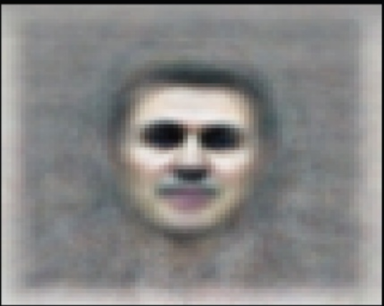
Who can tell me what NN is ? (1)
All commentaries just "quote" this image.
(Case 1) Cat
(Case 2) Celebrity

Slide 50
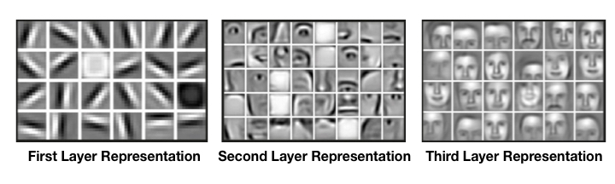
Who can tell me what NN is ? (1)
Do they think "there's no point in explaining"?
At least, I(Ebata) didn't know what was what.

